Slide 1
BAD CUSTOMER DETECTION
Group 5:
Roman Burekhin
Thien An Trinh
Shoaib ahmed khan
Joy Vahini Varatharaajah
Athira Devan
Pratheep kumar venkatrangam
Ahmad AlHammad
Esther Yu

Slide 2
Contents
Business Value
Exploratory Data Analysis
Data preprocessing
Default models
Tuning model
Feature selection
Retune model with new refined data
Threshold Analysis

Slide 3



1. Business VALUE
Purpose: predicting default on a loan among individuals (bad client detection)
Model relevance:
credit risk reduction
reduction of banks' reserves, and, accordingly, profit growth, due to an advanced approach to assessing credit risks.
Who is interested in this model:
Any financial institutions
Marketplaces
Example:
- Raiffeisen bank case: decrease in reserves by 27 billion rub. (550 million CAD) in Russia in 2020 *
* Source: https://www.raiffeisen.ru/about/investors/annualreport/

Slide 4
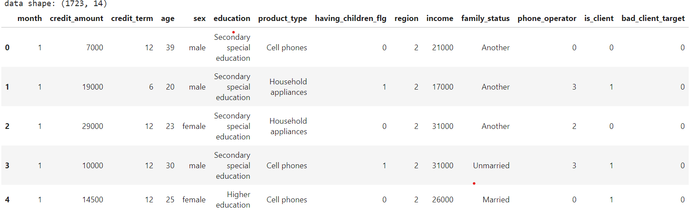
Data description
The dataset contains 1723 rows and 14 columns. Moreover, the dataset contains zero missing values.

Slide 5
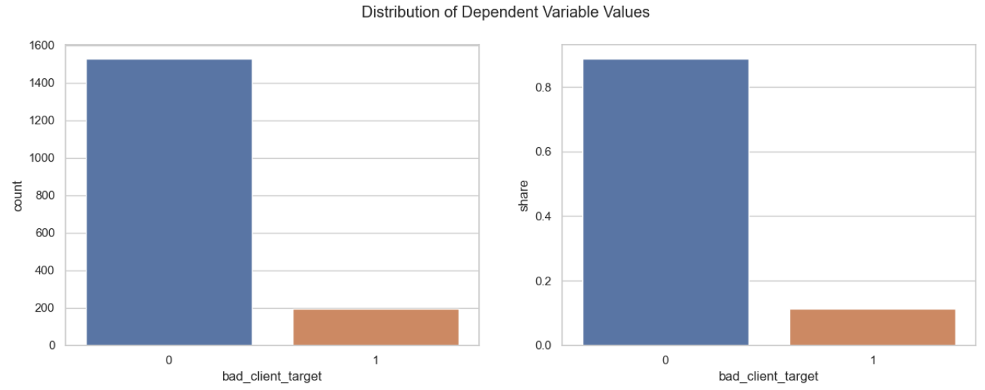
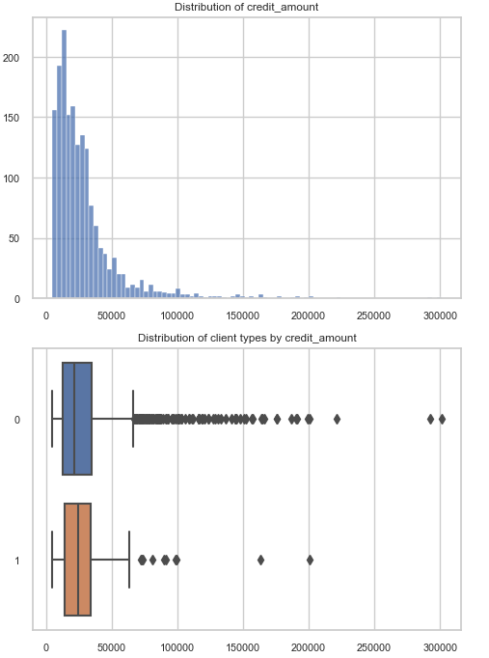
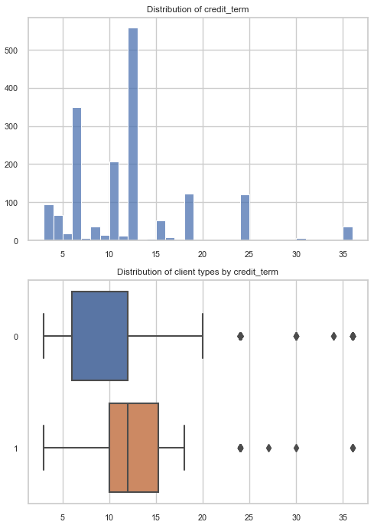
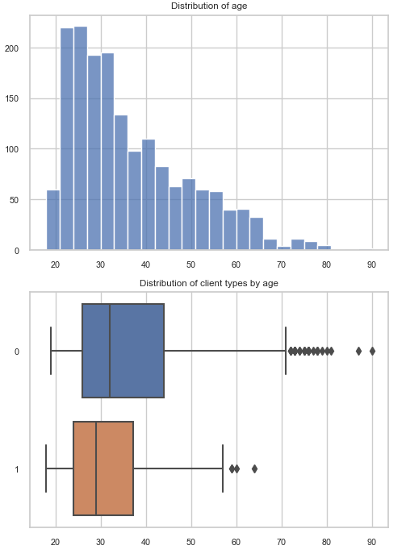
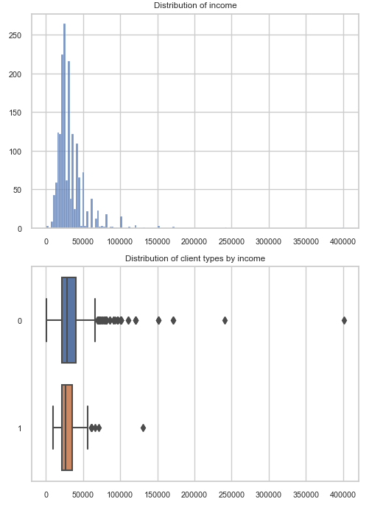
2. Exploratory Data Analysis
Dependent Variable
Bad_client_target
Independent Variable
Numerical Variable
Credit_amount
Credit_term
Age
Income
Categorical Variable
Month
Sex
Education
Product_type
Having_children_flg
Region
Family_status
Phone_operator
Is_client
Credit_Amount
Credit_Term
Age
Income

Slide 6
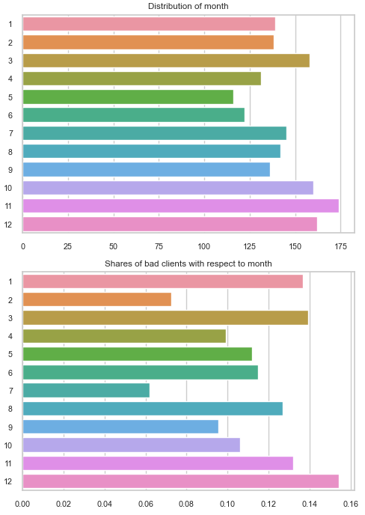
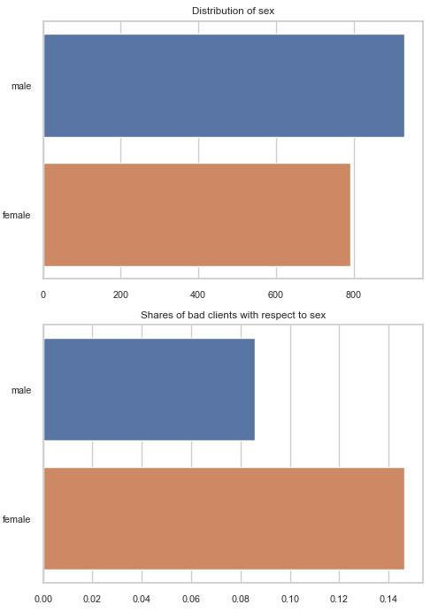
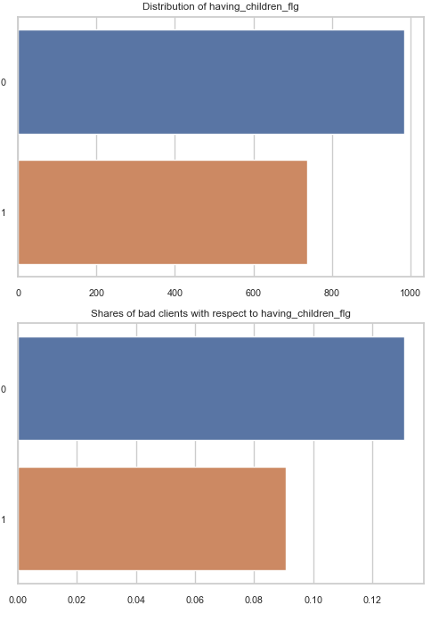
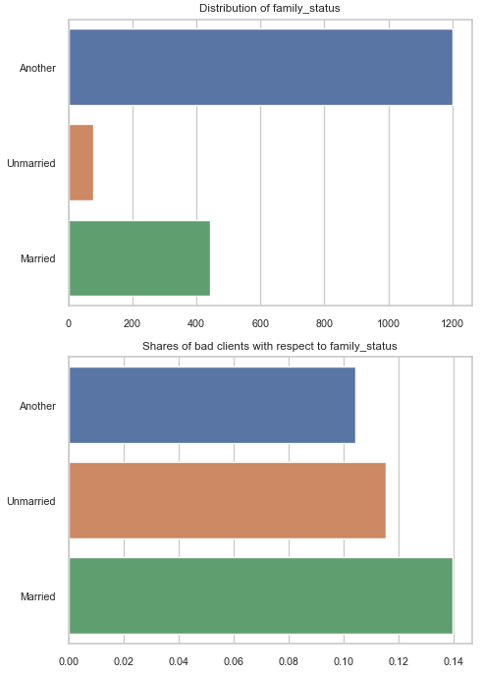
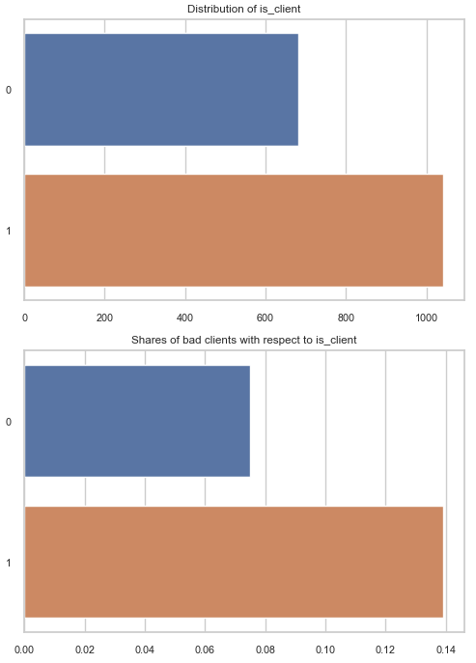
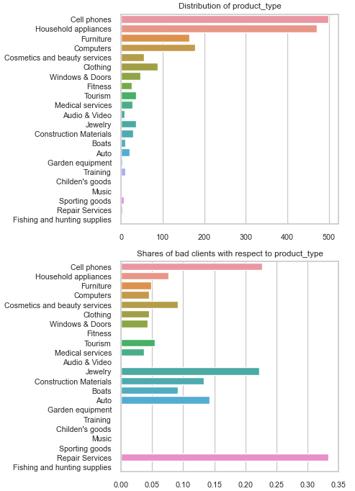
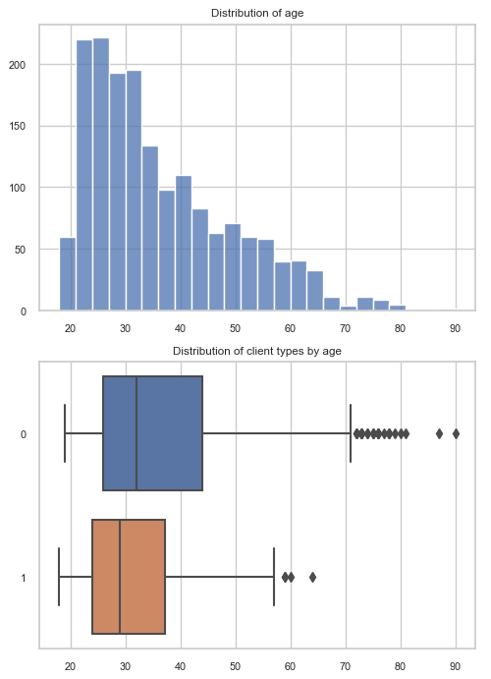
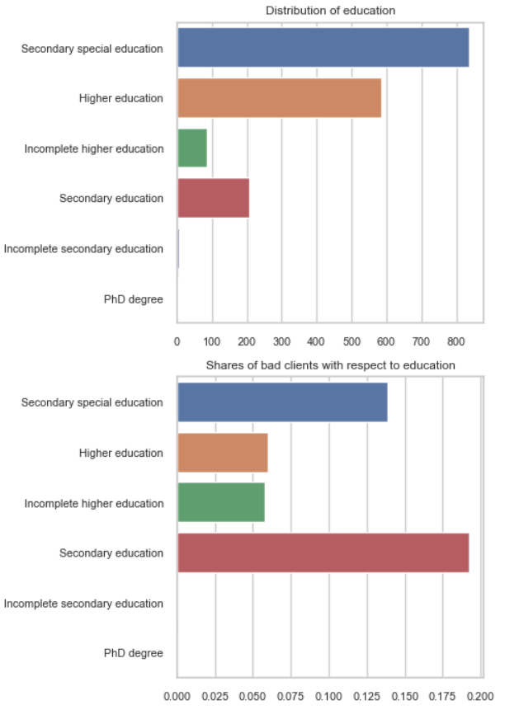
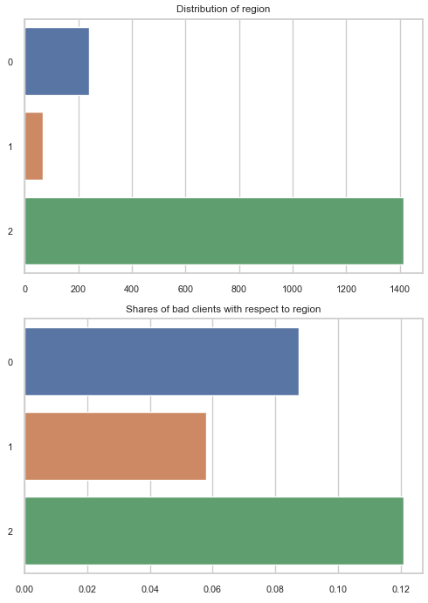
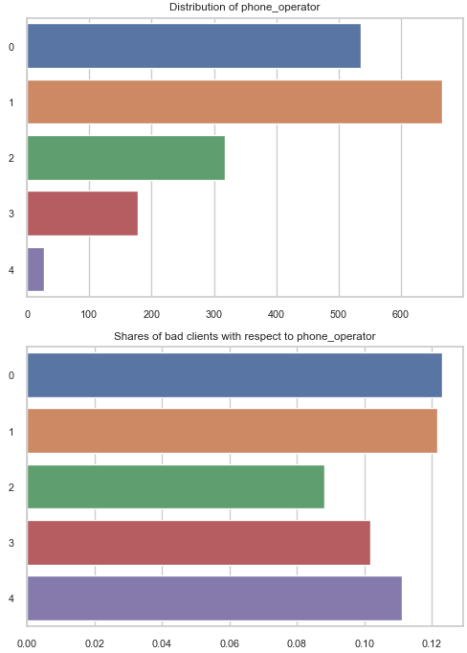
Month
Sex
Having_children_flg
Family_status
Is_client
Product Type
Age
Education
Phone Operator
Region
Most bad client are in December, minority are in July
There are outliers in credit amount.
Bad clients having credit time
Female are bad client more frequently
People with only secondary education are bad clients more frequently
It seems that loan for cell phone is the most risky
People with children are less risky clients
People from region 3 are riskier
There are outliers in income
Marriage status, phone operator don’t influence the probability of client default
Clients of bank are more risky

Slide 7
3. Data preprocessing
One hot encoding: Essential process of converting the categorical data variables to be provided to machine and deep learning algorithms which in turn improve predictions as well as classification accuracy of a model
Education
education_Higher education
education_Incomplete higher education
education_Incomplete secondary education
education_PhD degree
education_Secondary education
education_Secondary special education
Product_type
product_type_Audio & Video | product_type_Repair Services
product_type_Auto | product_type_Sporting goods
product_type_Boats | product_type_Tourism
product_type_Cell phones | product_type_Training
product_type_Construction Materials | product_type_Windows & Doors
product_type_Fitness | product_type_Household appliances
product_type_Furniture | product_type_Cosmetics and beauty services
product_type_Garden equipment | product_type_Fishing and hunting supplies
product_type_Jewelry | product_type_Childen_good
product_type_Medical services | product_type_Clothing
product_type_Music | product_type_Computers
Family_status
family_status_Another
family_status_Married
family_status_Unmarried
sex
Sex_female
Sex_male

Slide 8
4. Default models
Train and test split
Splitting ratio
Test Samples : Train Samples
30% : 70%
517 images : 1206 images
Bad_client_target | Train images
0 | 1073
1 | 133
Bad_client_target | Test images
0 | 454
1 | 63

Slide 9
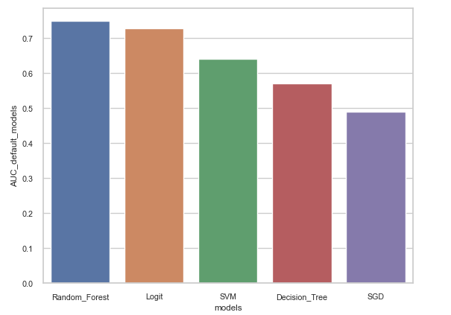
Models | AUC default models
Random Forest | 0.74
Logit | 0.72
SVM | 0.64
Decision Tree | 0.57
SGD | 0.49
The best default model is Random Forest

Slide 10
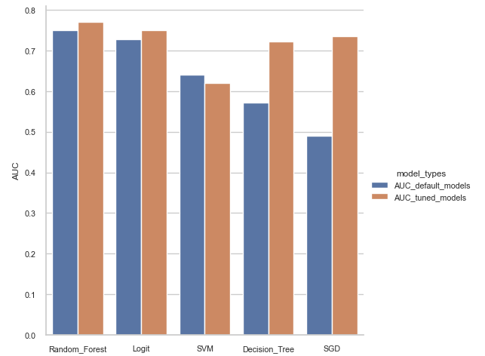
5. Tuning model
Models | AUC default models | AUC tuned models
Random Forest | 0.74 | 0.77
Logit | 0.72 | 0.74
SVM | 0.64 | 0.62
Decision Tree | 0.57 | 0.72
SGD | 0.49 | 0.73
The best model is Random Forest
With:
Criterion = gini
Max_depth = 6
Max_features = 7
N_estimators = 100
All of the models attained better AUC results except SVM

Slide 11
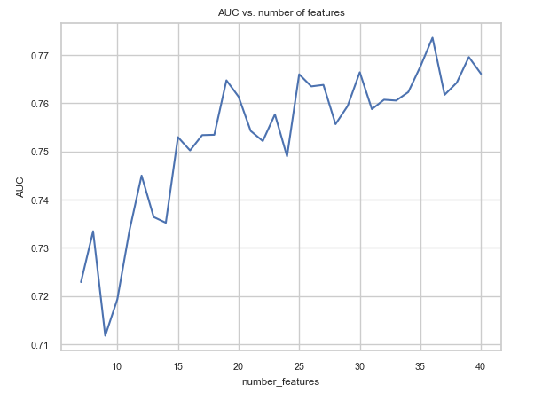
6. Feature selection
Recursive feature Elimination RFE: Fits a model and removes the weakest feature (or features) until the specified number of features is reached
Number feature | AUC
7 | 0.72
8 | 0.73
9 | 0.71
10 | 0.71
11 | 0.73
12 | 0.74
13 | 0.73
14 | 0.73
15 | 0.75
16 | 0.75
17 | 0.75
18 | 0.75
19 | 0.76
20 | 0.76
21 | 0.75
22 | 0.75
23 | 0.75
24 | 0.74
Number feature | AUC
25 | 0.76
26 | 0.76
27 | 0.76
28 | 0.75
29 | 0.75
30 | 0.76
31 | 0.75
32 | 0.76
33 | 0.76
34 | 0.76
35 | 0.76
36 | 0.77
37 | 0.76
38 | 0.76
39 | 0.76
40 | 0.76
Selected Features= 36
Month
credit_amount
credit_term
Age
having_children_flg
Region
Income
phone_operator
is_client
education_Higher education
education_Incomplete higher education
education_Incomplete secondary education
education_Secondary education
education_Secondary special education
product_type_Audio & Video
product_type_Auto
product_type_Boats
product_type_Cell phones
product_type_Clothing
product_type_Computers
product_type_Construction Materials
product_type_Cosmetics and beauty services
product_type_Fitness
product_type_Furniture
product_type_Garden equipment
product_type_Household appliances
product_type_Jewelry
product_type_Medical services
product_type_Sporting goods
product_type_Tourism
product_type_Training
product_type_Windows & Doors
family_status_Another
family_status_Married
family_status_Unmarried
sex_female

Slide 12
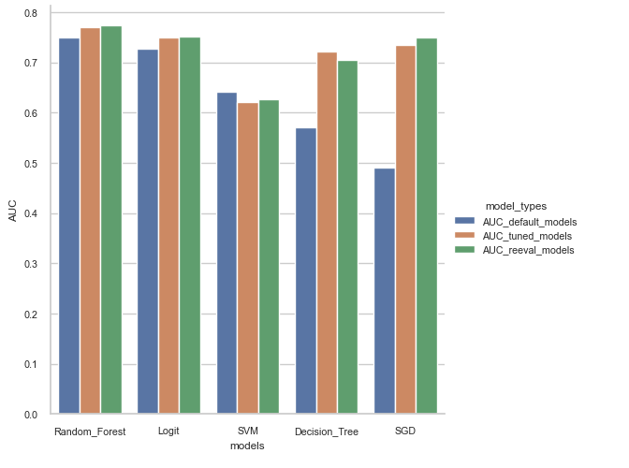
Default vs. Tuned vs. Re-evaluated Models
Models | AUC_default_models | AUC_tuned_models | AUC_reeval_models
Random_Forest | 0.74 | 0.77 | 0.77
Logit | 0.72 | 0.74 | 0.75
SVM | 0.64 | 0.62 | 0.62
Decision_Tree | 0.57 | 0.72 | 0.70
SGD | 0.49 | 0.73 | 0.74
The best model after feature selection is Random Forest

Slide 13
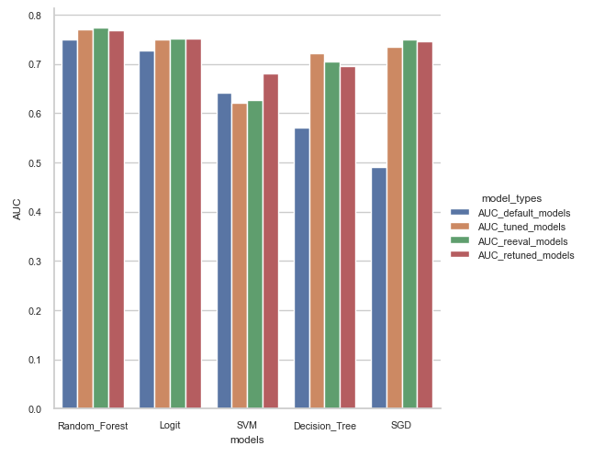

7. Retune model with new refined data
Models | AUC_default_models | AUC_tuned_models | AUC_reeval_models | AUC_retuned_models
Random_Forest | 0.74 | 0.77 | 0.77 | 0.76
Logit | 0.72 | 0.74 | 0.75 | 0.75
SVM | 0.64 | 0.62 | 0.62 | 0.68
Decision_Tree | 0.57 | 0.72 | 0.70 | 0.69
SGD | 0.49 | 0.73 | 0.74 | 0.74
The best model after feature selection and fine tuning is Random Forest

Slide 14
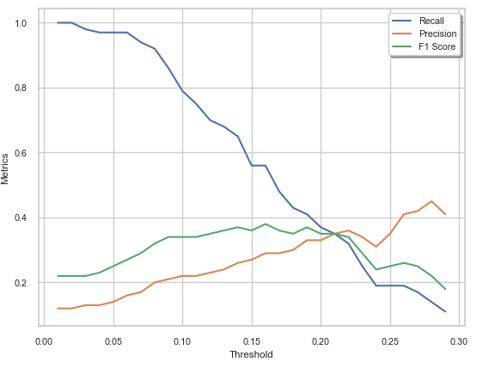
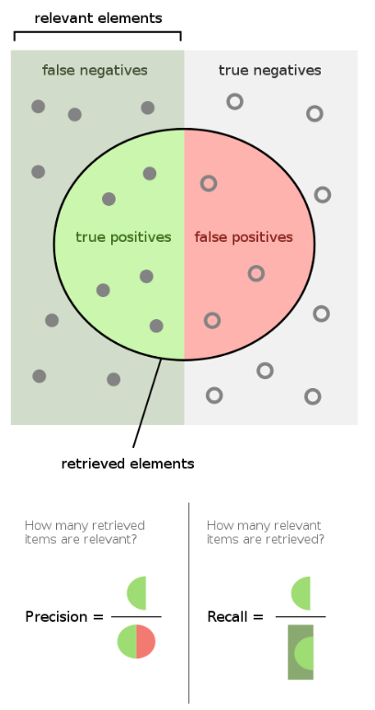
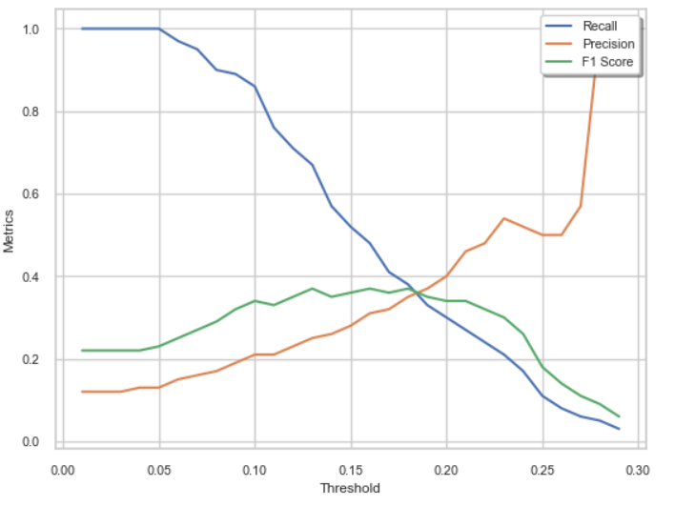
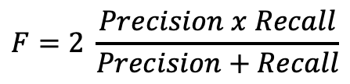
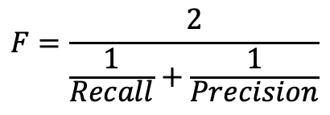
8. Threshold Analysis
$$F=\frac{2}{\frac{1}{Recall}+\frac{1}{Precision}}$$
$$F=2 \frac{Precision x Recall}{Precision+Recall}$$
Selecting the threshold is a trade-off between Recall and Precision
Source: Wikipedia

Slide 15
Conclusion
In these experiments, Random Forest algorithm with the refined dataset gave the highest ROC AUC.
After finding the best method of detecting bad clients, threshold analysis should be done, and the threshold value is set based on specific business purposes.

